Slide 1
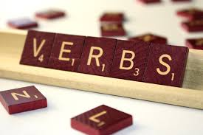
Verbs
By : Grant Collins

Slide 2
Action Verbs
Action Verbs- A verb that describes action
Example-I have to run fast to class before I’m late!

Slide 3
Verbs
Verbs-A word that describes a action.
Example: I kicked the ball into the goal.

Slide 4
Adverbs
Adverbs-a word or phrase that modifies an adjective, and a verb.
Example: Softly she sang to the baby.

Slide 5
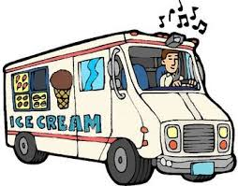
Past Tense Verbs
Past Tense Verbs- A verb showing action that has happened in the past.
Example: We raced to the Ice Cream Truck.

Slide 6
Present Tense Verbs
The action that is happening that very moment.
Example: He hits the ball out of the field.

Slide 7
Future Tense Verbs
A action that has not yet happened.
Example: The world will end.

Slide 8
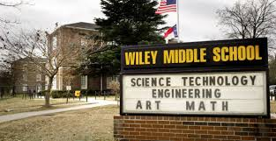
Thanks for watching!

